Slide 1
Multiple sequence alignment using partial order graphs
Christopher Lee, Catherine Grasso and Mark F. Sharlow
BIOINFORMATICS, Vol.18, no.3, 2002, pp.452–464
Presenter : Hsiao-Yen Chang
Date : March 7, 2007

Slide 2
Abstract
Motivation: Progressive Multiple Sequence Alignment (MSA) methods
depend on reducing an MSA to a linear profile for each alignment step.
However, this leads to loss of information needed for accurate
alignment, and gap scoring artifacts.
Results: We present a graph representation of an MSA that can itself
be aligned directly by pairwise dynamic programming, eliminating the
need to reduce the MSA to a profile. This enables our algorithm (Partial
Order Alignment) to guarantee that the optimal alignment of each new
sequence versus each sequence in the MSA will be considered.
Moreover, this algorithm introduces a new edit operator, homologous
recombination, important for multidomain sequences. The algorithm
has improved speed (linear time complexity) over existing MSA
algorithms, enabling construction of massive and complex alignments.
We demonstrate the utility of this algorithm on a family of multidomain
SH2 proteins, and on EST assemblies containing alternative splicing
and polymorphism.

Slide 3
Introduction
Dynamic programming
  This algorithm can be extended to align N sequences optimally, but requires O(L^{N} ) time.
Progressive alignment
  pairwise alignment
  guide tree
  Recursive multiple alignment
1
1,2
2
1,3
3
1,4
4
2,3
2
2,4
3
3,4
4
1

Slide 4


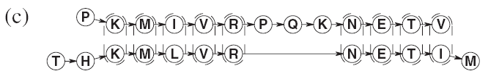
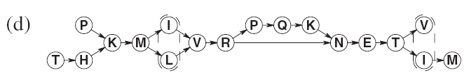
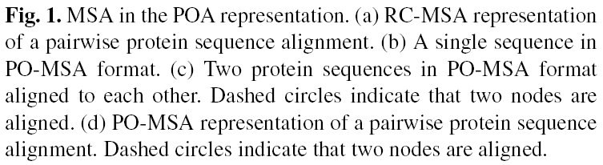
Partial Order Multiple Sequence Alignment (PO-MSA) data structure

Slide 5
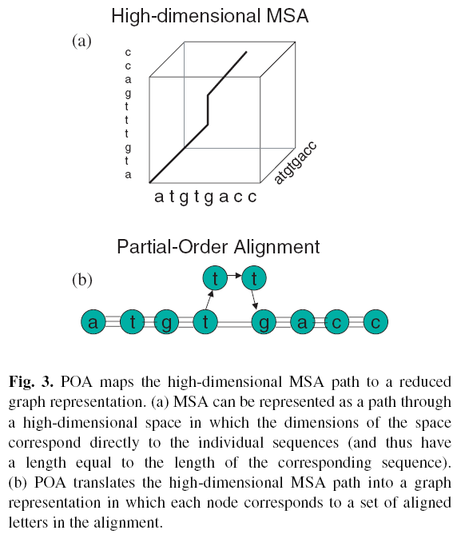

Slide 6
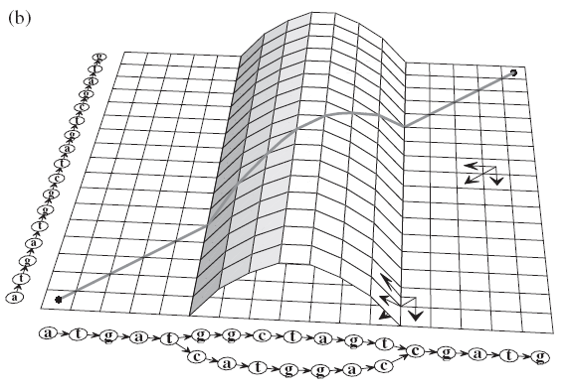
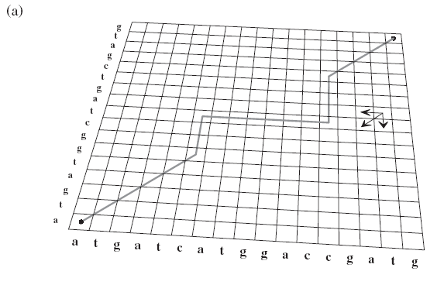
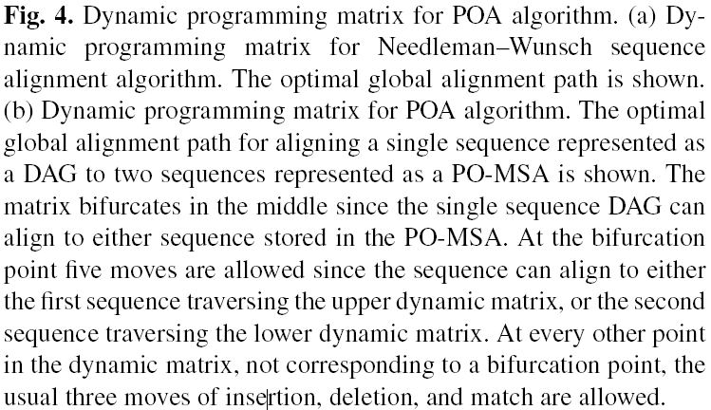
Dynamic programming Partial Order Alignment (POA)

Slide 7
Alignment scoring
The score for each possible move is just the sum of the transition score associated with that move (for a diagonal move, the substitution score s(n,m) for aligning residue n to residue m; for a horizontal or vertical, the gap penalty △),plus the saved score S(p,m-1) at the predecessor cell pointed to by the move.
S(p,m-1)+s(n,m)
S(n,m)=max S(p,m)+ △(n) (1)
S(n,m-1)+ △(m)
considering all predecessor nodes p that have a
directed edge from p → n.

Slide 8
Computational complexity
For n_{p} predecessor nodes, the number of moves whose score must be calculated in (1) is 2n_{p}+1.
For standard sequence alignment, where n_{p}=1 by definition, there are exactly three moves, and the total time complexity for aligning a sequences of length N,M is O(3NM).
For the POA algorithm, the the total time complexity for aligning a sequences of length M to an N node PO-MSA with n_{p} average number of predecessors per node is O((2n_{p}+1) NM).

Slide 9
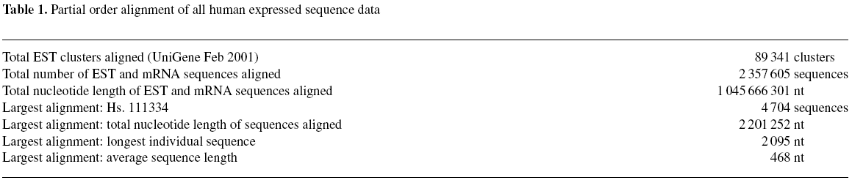
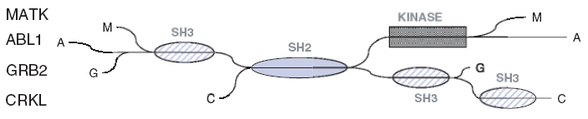
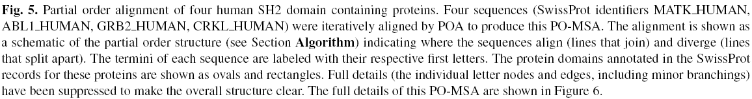
Partial order structure in biological sequence alignments

Slide 10
